Slide 1
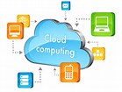
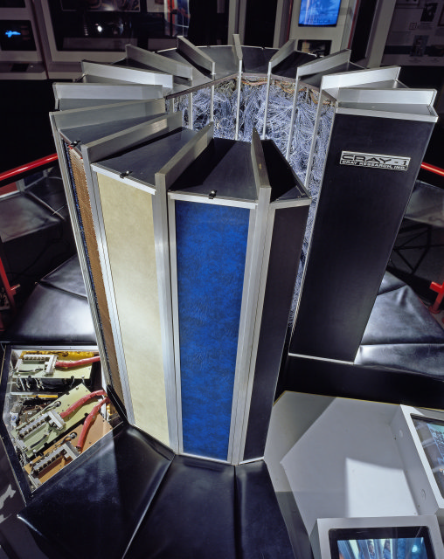
  ITA : 6009 Cloud Computing
  Module 6 -Enterprise Cloud-Based High Performance Computing (HPC) Applications
www.nadeshrk.webs.com

Slide 2
Overview- HPC
Cloud computing is emerging as an alternative to supercomputers for some of the high-performance computing (HPC) applications that do not require a fully dedicated machine
Advantages of using cloud computing in HPC applications
  cost effective alternative
  reduces the risks caused by under-provisioning
  reduces the underutilization of resources caused by overprovisioning
  the built-in virtualization support in the cloud support flexibility, customization, security, migration and resource control

Slide 3
Motivation
It still remains unclear whether, and when, HPC in the cloud can become a feasible substitute or complement to supercomputers.
Based on the expansion of clouds to HPC applications, HPC users and cloud providers faced with the problem of choosing the best platform by having a limited knowledge about application characteristics, platform capabilities and cost
why and who should choose (or not choose) cloud for HPC
For what applications, and how should cloud be used for HPC

Slide 4
What is HPC?
Solve large computational problems
HPC is best described as massively parallel
High bandwidth, low latency, cluster-based
Becoming critical part of R&D for businesses
Traditionally required specialized staffing
www.nadeshrk.webs.com

Slide 5

When We Need High Performance Computing?
Case1
  To perform time-consuming operations in less time/ before a tighter deadline.
    I am a bioinformatic engineer.
    I need to run DNA-matching programs.
    I’d rather have the result in 5 minutes than in 5 days so that I can say that the studied ADN sequence contain significant mutations sooner.
,

Slide 6
When We Need High Performance Computing
Case 2
  To do a high number of operations per seconds
    I am an engineer of Amazon.com
    My Web server gets 1,000 hits per seconds
    I’d like my web server and my databases to handle 1,000 transactions per seconds so that customers do not experience bad delays
      Amazon does “process” several GBytes of data per seconds
,

Slide 7
Super Computers
A supercomputer is a computer with a high level of computing performance compared to a general-purpose computer.
Performance of a supercomputer is measured in floating-point operations per second (FLOPS) instead of million instructions per second (MIPS)
www.nadeshrk.webs.com

Slide 8
Super Computer
year | Supercomputer | Peak speed_x000b_(Rmax) | Location
2018 | IBM Summit | 122.3 PFLOPS | Oak Ridge, U.S.
2016 | Sunway TaihuLight | 93.01 PFLOPS | Wuxi, China
2013 | NUDT Tianhe-2 | 33.86 PFLOPS | Guangzhou, China
2012 | Cray Titan | 17.59 PFLOPS | Oak Ridge, U.S.
2012 | IBM Sequoia | 17.17 PFLOPS | Livermore, U.S.
2011 | Fujitsu K computer | 10.51 PFLOPS | Kobe, Japan
2010 | Tianhe-IA | 2.566 PFLOPS | Tianjin, China
2009 | Cray Jaguar | 1.759 PFLOPS | Oak Ridge, U.S.
2008 | IBM Roadrunner | 1.026 PFLOPS | Los Alamos, U.S.
 |  | 1.105 PFLOPS
www.nadeshrk.webs.com

Slide 9
HPC as a Service
AWS
AZURE
Google Cloud Platform
IBM Spectrum Computing
Penguin Computing on Demand(POD)
Nimbix
www.nadeshrk.webs.com

Slide 10
Database in the Cloud
Database is a key component in most computing infrastructures.
Database allows users to store data in an organized manner and retrieve them easily.
Relational Database Versus non-relational database (NOSQL)
They are made up of individual tables and these tables cannot have defined relationships between them, unlike in relational databases

Slide 11
Relational Versus Non-Relational
One can retrieve the account balance of a specific Customer given the Customer's name through table joins using SQL due to the Primary Key/Foreign Key relationship.
In a non-relational database for the same schema, without the relationship, the developer has to use application code to obtain the Customer's account number and then access the Account table and match the account number obtained previously to retrieve the balance.

Slide 12
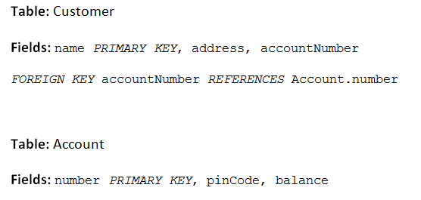
Retrieving Data

Slide 13
NoSQL DATABASE
A NoSQL (originally referring to "non SQL", "non relational" or "not only SQL")database provides a mechanism for storage and retrieval of data which is modeled in means other than the tabular relations used in relational databases. ...
NoSQL databases are increasingly used in big data and real-time web applications.
www.nadeshrk.webs.com

Slide 14
Cassandra
Apache Cassandra is an open source distributed database management system designed to handle large amounts of data across many commodity servers, providing high availability with no single point of failure.
www.nadeshrk.webs.com

Slide 15
What is Hadoop and Cassandra?
Apache Cassandra is a NoSQL database ideal for high-speed, online transactional data.
Hadoop is a big data analytics system that focuses on data warehousing and data lake use cases.
www.nadeshrk.webs.com

Slide 16
Memcached
Free & open source, high-performance, distributed memory object caching system, generic in nature, but intended for use in speeding up dynamic web applications by alleviating database load.
Memcached is an in-memory key-value store for small chunks of arbitrary data (strings, objects) from results of database calls, API calls, or page rendering.
Memcached is simple yet powerful.
Its simple design promotes quick deployment, ease of development, and solves many problems facing large data caches. Its API is available for most popular languages.
www.nadeshrk.webs.com

Slide 17

HBase: Overview
HBase is a distributed column-oriented data store built on top of HDFS
HBase is an Apache open source project whose goal is to provide storage for the Hadoop Distributed Computing
Data is logically organized into tables, rows and columns

Slide 18
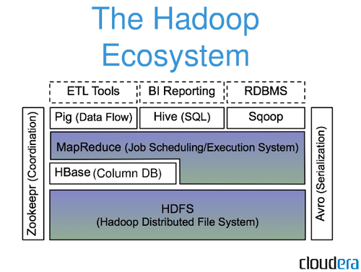
HBase: Part of Hadoop’s Ecosystem
HBase is built on top of HDFS
HBase files are internally stored in HDFS

Slide 19
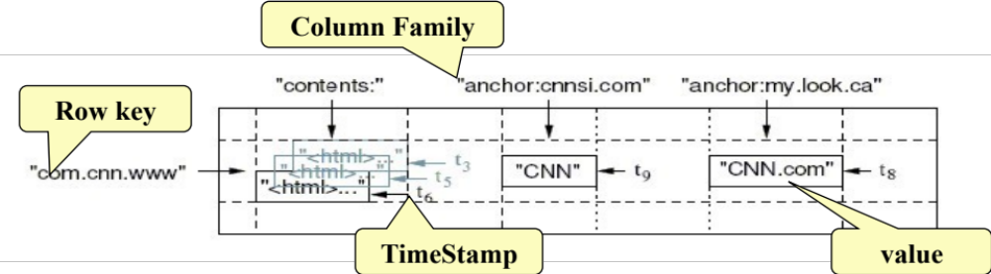
HBase Data Model
HBase is based on Google’s Bigtable model
  Key-Value pairs

Slide 20
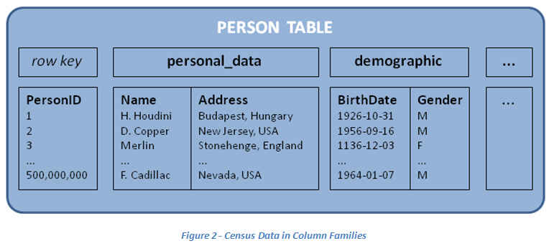
HBase: Keys and Column Families
Each record is divided into Column Families
Each row has a Key
Each column family consists of one or more Columns

Slide 21
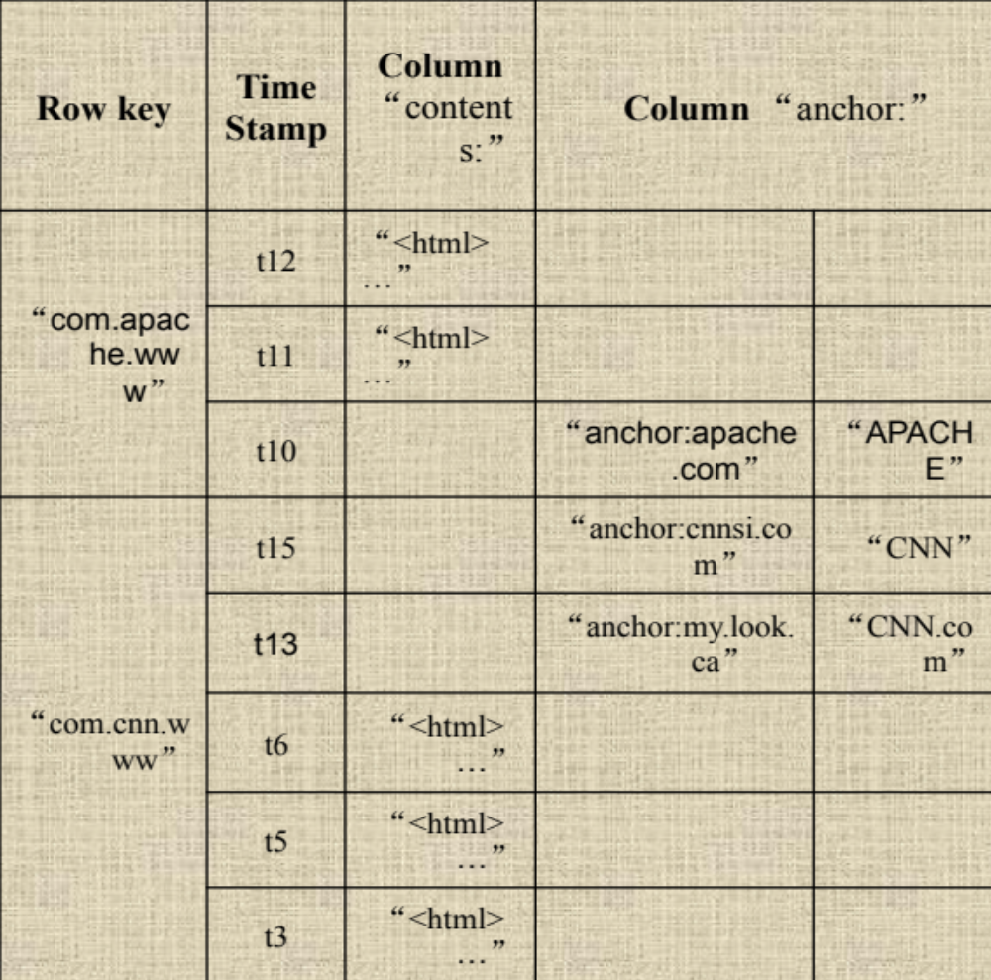
Column family named “anchor”
Column family named “Contents”
Key
  Byte array
  Serves as the primary key for the table
  Indexed far fast lookup
Column Family
  Has a name (string)
  Contains one or more related columns
Column
  Belongs to one column family
  Included inside the row
    familyName:columnName
Column named “apache.com”

Slide 22
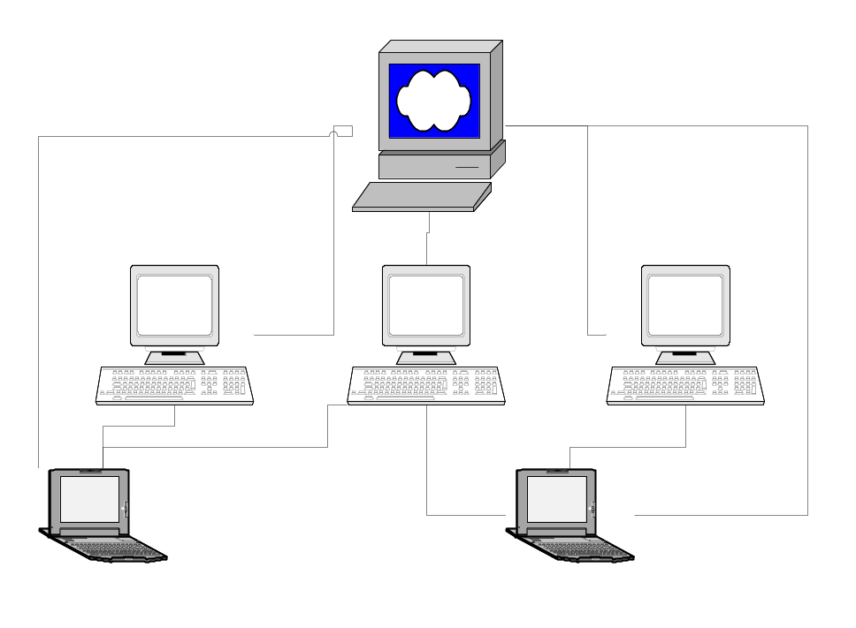
Three Major Components-HBASE Architecture
The HBaseMaster
  One master
The HRegionServer
  Many region servers
The HBase client

Slide 23
HBase Components
Region
  A subset of a table’s rows, like horizontal range partitioning
  Automatically done
RegionServer (many slaves)
  Manages data regions
  Serves data for reads and writes (using a log)
Master
  Responsible for coordinating the slaves
  Assigns regions, detects failures
  Admin functions

Slide 24
HPC Hardware
What is GPGPU computing?
GPGPU (general purpose computing on graphics processing units) is a methodology for high-performance computing that uses graphics processing units to crunch data.
www.nadeshrk.webs.com

Slide 25
How is a GPU different from a CPU?
GPU properties lead to a very different processor architecture from traditional CPUs.
CPUs devote a lot of resources (primarily chip area) to make single streams of instructions run fast, including caching to hide memory latency and complex instruction stream processing (pipelining, out-of-order execution and speculative execution).
GPUs, on the other hand, use the chip area for hundreds of individual processing elements that execute a single instruction stream on many data elements simultaneously.
www.nadeshrk.webs.com

Slide 26
HPC Hardware
What applications work best with GPGPUs?
Data parallel means that a processor can execute the operation on different data elements simultaneously.
Throughput intensive means that the algorithm is going to process lots of data elements, so there will be plenty to operate on in parallel.
www.nadeshrk.webs.com

Slide 27
HPC Hardware
SSD
NETWORK
SWITCHES
www.nadeshrk.webs.com

